Slide 1
LESSON 6.1a
Exponential Growth and Decay

Slide 2
Today you will:
Learn what exponential functions are and how to graph them.
Learn what exponential growth and decay functions are and how they are used in the real world.
Practice using English to describe math processes and equations

Slide 3
Core Vocabulary:
Exponential function, p. 296
Exponential growth function, p. 296
Growth factor , p. 296
Exponential decay function , p. 296
Decay factor , p. 296
Asymptote , p. 296
Previous:
Properties of exponents

Slide 4
Exponential Function
Variable is in the exponent!
$$y=ab^{x}$$
Leading coefficient
Base
Not a variable, just a number

Slide 5

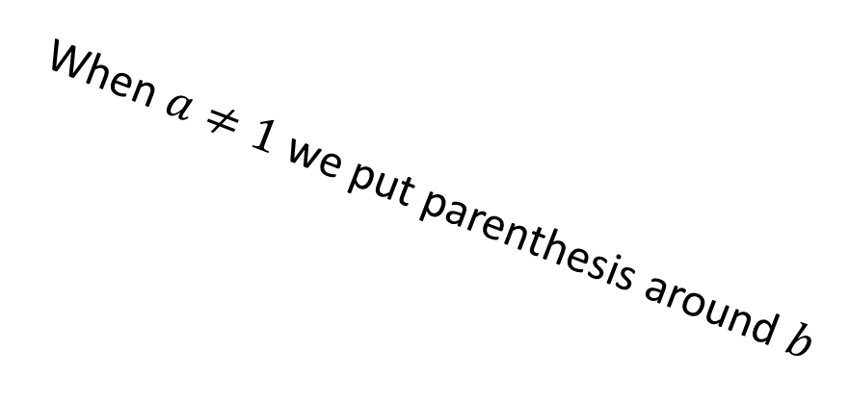
Examples of exponential functions:
$y=2^{x}$
$y=3(1.2)^{x}$
$y=1.3(.72)^{x}$
$$a=1, b=2$$
$$a=3, b=1.2$$
$$a=1.3, b=.72$$
When $a≠1$ we put parenthesis around $b$

Slide 6
Exponential Growth Function
Exponential function where $a>0$ and $b>1$
Example: $y=2(1.1)^{x}$
Exponential Decay Function
Exponential function where $a>0$ and $0<b<1$, i.e. $b$ is a positive decimal/fraction less than 1
Example: $y=4(0.32)^{x}$

Slide 7
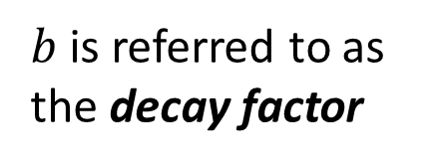
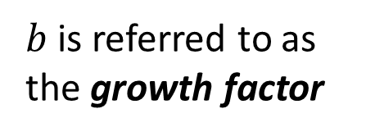
What do graphs of exponential functions look like?
Parent function for exponential functions is:
$f\left(x\right)=b^{x}$ $(a=1)$
Growth
Decay
$b$ is referred to as
the growth factor
$b$ is referred to as
the decay factor

Slide 8
Definition: Asymptote
A line that a graph approaches, gets closer and closer to but never touches.
For exponential functions, the $x$-axis is an asymptote

Slide 9
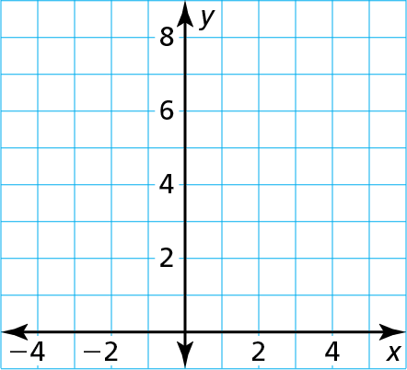
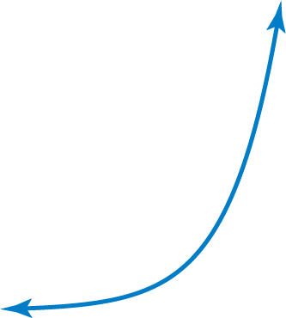

Tell whether each function represents exponential growth or exponential decay. Then graph the function.
a. y $=\text{2}$^{x}
b. y $=\left(\frac{\text{1}}{\text{2}}\right)\text{x}$
SOLUTION
a. Step 1
Identify the value of the base. The base, 2, is greater than 1, so the function represents exponential growth.
Step 2
Make a table of values.
x | $−$2 | $−$1 | 0 | 1 | 2 | 3
y | $$\frac{\text{1}}{\text{4}}$$ | $$\frac{\text{1}}{\text{2}}$$ | 1 | 2 | 4 | 8
y $=\text{2}$^{x}
Step 3
Plot the points from the table.
Step 4
Draw, from left to right, a smooth curve that begins just above the x-axis, passes through the plotted points, and moves up to the right.

Slide 10
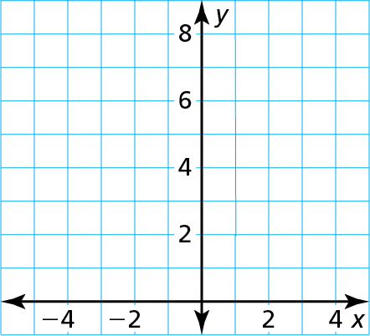
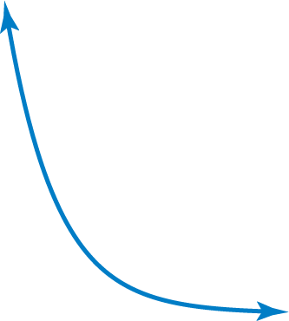

Identify the value of the base. The base, $\frac{\text{1}}{\text{2}}$, is greater than 0 and less than 1, so the function represents exponential decay.
b. Step 1
Step 2
Make a table of values.
x | $−$3 | $−$2 | $−$1 | 0 | 1 | 2
y | 8 | 4 | 2 | 1 | $$\frac{\text{1}}{\text{2}}$$ | $$\frac{\text{1}}{\text{4}}$$
Step 3
Plot the points from the table.
y $=\left(\frac{\text{1}}{\text{2}}\right)\text{x}$
Step 4
Draw, from right to left, a smooth curve that begins just above the x-axis, passes through the plotted points, and moves up to the left.

Slide 11
Exponential Models
Exponential equations/functions that reflect (model) real-world situations.
A common example is a value you are tracking that increases or decreases by a fixed percentage over a regular period of time (a year).
…where $a$ is the initial/starting value
$r$ is the rate of change
$t$ is the amount of time that has past
$(1+r)$ is the growth factor
$(1−r)$ is the decay factor

Slide 12
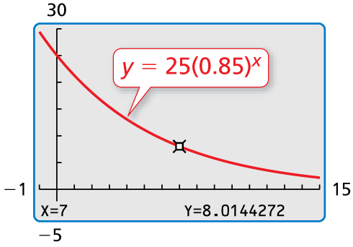
The value of a car y (in thousands of dollars) can be approximated by the model y $=$ 25(0.85)^{t}, where t is the number of years since the car was new.
a. Tell whether the model represents exponential growth or exponential decay.
b. Identify the annual percent increase or decrease in the value of the car.
c. Estimate when the value of the car will be $8000.
The percent decrease,
15%, tells you how much
value the car loses each
year. The decay factor,
0.85, tells you what
fraction of the car’s value
remains each year.
SOLUTION
a. The base, 0.85, is greater than 0 and less than 1, so the model represents exponential decay.
b. Because t is given in years and the decay factor 0.85 $=$ 1$−$ 0.15, the annual percent decrease is 0.15, or 15%.
c. Use the trace feature of a graphing calculator to determine that y $≈$ 8 when t $=$ 7. After 7 years, the value of the car will be about $8000.

Slide 13
Homework
Pg 300, #3-22

